Slide 1
COMPILER CONSTRUCTION CS F363
Syntax Analysis
Dr. R. Elakkiya, AP/CS

Slide 2
Text Book
Aho, Lam, Sethi and Ullman, “Compilers-Principles, Techniques & Tools”, Pearson/Addison-Wesley, Second Edition, 2013.

Slide 3
Text Book Reading:
Chapter 4
Section 4.1 to 4.9

Slide 4
Overview
Syntax Analysis
Introduction
Context Free Grammars
Writing a Grammar
Bottom-Up Parsing
Simple LR
Powerful LR
Using Ambiguous Grammars
Top-Down Parsing
Parser Generators

Slide 5
Overview
Syntax Analysis
Introduction
Context Free Grammars
Writing a Grammar
Bottom-Up Parsing
LR and RR Grammars
Using Ambiguous Grammars
Top-Down Parsing
Parser Generators

Slide 6
Top Down Parsing
The parse tree is created top to bottom.
Top-down parser
Recursive Descent Parsing
Predictive Parsing

Slide 7
Top Down Parsing
Top-down parser
Recursive-Descent Parsing
Backtracking is needed (If a choice of a production rule does not work, we backtrack to try other alternatives.)
It is a general parsing technique, but not widely used.
Not efficient

Slide 8
Top Down Parsing
Top-down parser
Predictive Parsing
no backtracking
efficient
needs a special form of grammars (LL(1) grammars).
LL(1) – no multiply defined entries in parsing table, 1st L for scanning from left to right and 2nd L for producing a leftmost derivation. 1 for using one i/p symbol of lookahead at each step.
Recursive Predictive Parsing is a special form of Recursive Descent parsing without backtracking.
Non-Recursive (Table Driven) Predictive Parser is also known as LL(1) parser.

Slide 9
Recursive-Descent Parsing (uses Backtracking)
Backtracking is needed.
It tries to find the left-most derivation.
S → aBc
B → bc | b
S S
input: abc
a B c a B c
b c b
fails, backtrack

Slide 10
Compute FIRST for Any String X
If X is a terminal symbol
➔ FIRST(X)={X}
If X is a non-terminal symbol and X → ε is a production rule ➔ ε is in FIRST(X).
If X is a non-terminal symbol and X → Y₁Y₂..Y_{n} is a production rule
➔ if a terminal a in FIRST(Y_{i}) and ε is in all FIRST(Y_{j}) for j=1,...,i-1 then a is in FIRST(X).
➔if ε is in all FIRST(Y_{j}) for j=1,...,n for j=1,...,n then ε is in FIRST(X).

Slide 11
Compute FIRST for Any String X
If X is ε
➔FIRST(X)={ε}
If X is Y₁Y₂..Y_{n} ➔if a terminal a in FIRST(Y_{i}) and ε is in all FIRST(Y_{j}) for j=1,...,i-1then a is in FIRST(X).
➔if ε is in all FIRST(Y_{j}) for j=1,...,n then ε is in FIRST(X).

Slide 12
Example 1
E → TE’
E’ → +TE’ | ε
T → FT’
T’ → *FT’ | ε
F → (E) | id
FIRST(E) = {(,id}
FIRST(E’) = {+, ε}
FIRST(T) = {(,id}
FIRST(T’) = {*, ε}
FIRST(F) = {(,id}

Slide 13
Example 2
S →ABCDE
A → a|ε
B → b|ε
C → c
D →d|ε
E →e|ε

Slide 14
Example 2: Solution
S →ABCDE
A → a|ε
B → b|ε
C → c
D →d|ε
E →e|ε
FIRST(S) = {a,b,c}
FIRST(A) = {a, ε}
FIRST(B) = {b, ε}
FIRST(C) = {c}
FIRST(D) = {d, ε}
FIRST(E)= {e, ε}

Slide 15
Example 3
S →Bb|Cd
B → aB|ε
C → cC|ε

Slide 16
Example 3: Solution
S →Bb|Cd
B → aB|ε
C → cC|ε
FIRST(S) = {a,b,c,d}
FIRST(B) = {a, ε}
FIRST(C) = {c, ε}

Slide 17
Example 4
S →ACB|CbB|Ba
A →da|BC
B →g|ε
C→h|ε

Slide 18
Example 4: Solution
S →ACB|CbB|Ba
A →da|BC
B →g|ε
C→h|ε
FIRST(S) = {d,g,h,b,ε}
FIRST(A) = {d, g,h ε}
FIRST(B) = {g, ε}
FIRST(C) = {h, ε}

Slide 19
Thank you

Slide 20
Compute FOLLOW (for non-terminals)
If S is the start symbol
➔ $ is in FOLLOW(S)
if A → αBβ is a production rule
➔ everything in FIRST(β) is FOLLOW(B) except ε
If ( A → αB is a production rule ) or ( A → αBβ is a production rule and ε is in FIRST(β) ) ➔ everything in FOLLOW(A) is in FOLLOW(B)
We apply these rules until nothing more can be added to any follow set.

Slide 21
Example
E → TE’
E’ → +TE’ | ε
T → FT’
T’ → *FT’ | ε
F → (E) | id
FIRST(E) = {(,id}
FIRST(E’) = {+, ε}
FIRST(T) = {(,id}
FIRST(T’) = {*, ε}
FIRST(F) = {(,id}
FOLLOW(E) = { $, ) }
FOLLOW(E’) = { $, ) }
FOLLOW(T) = { +, $,) }
FOLLOW(T’) = { +, $,) }
FOLLOW(F) = {*,+, $,) }

Slide 22
Example 2
S →ABCDE
A → a|ε
B → b|ε
C → c
D →d|ε
E →e|ε

Slide 23
Example 2
FIRST(S) = {a,b,c}
FIRST(A) = {a, ε}
FIRST(B) = {b, ε}
FIRST(C) = {c}
FIRST(D) = {d, ε}
FIRST(E)= {e, ε}
S →ABCDE
A → a|ε
B → b|ε
C → c
D →d|ε
E →e|ε
FOLLOW(S) = { $}
FOLLOW(A) = {b,c}
FOLLOW(B) = { c }
FOLLOW(C) = { d,e,$}
FOLLOW(D) = {e,$}
FOLLOW(E) = {$}

Slide 24
Example 3
S →Bb|Cd
B → aB|ε
C → cC|ε

Slide 25
Example 3: Solution
S →Bb|Cd
B → aB|ε
C → cC|ε
FIRST(S) = {a,b,c,d}
FIRST(B) = {a, ε}
FIRST(C) = {c, ε}
FOLLOW(S) = { $}
FOLLOW(B) = {b}
FOLLOW(C) = {d}

Slide 26
Non-Recursive Predictive Parsing -- LL(1) Parser
Non-Recursive predictive parsing is a table-driven parser.
It is a top-down parser.
It is also known as LL(1) Parser.
input buffer
stack
Non-recursive Predictive Parser
output
Parsing Table

Slide 27
LL(1) Parser
Input Buffer
our string to be parsed. We will assume that its end is marked with a special symbol $.
Output
a production rule representing a step of the derivation sequence (left-most derivation) of the string in the input buffer.
Stack
contains the grammar symbols
at the bottom of the stack, there is a special end marker symbol $.
initially the stack contains only the symbol $ and the starting symbol S.
$S ⬅ initial stack
when the stack is emptied (ie. only $ left in the stack), the parsing is completed.

Slide 28
LL(1) Parser
Parsing table
a two-dimensional array M[A,a]
each row is a non-terminal symbol
each column is a terminal symbol or the special symbol $
each entry holds a production rule.

Slide 29
LL(1) Grammar
A grammar whose parsing table has no multiply-defined entries is said to be LL(1) grammar.
one input symbol used as a look-head symbol do determine parser action
LL(1) left most derivation
input scanned from left to right
The parsing table of a grammar may contain more than one production rule. In this case, we say that it is not a LL(1) grammar.

Slide 30
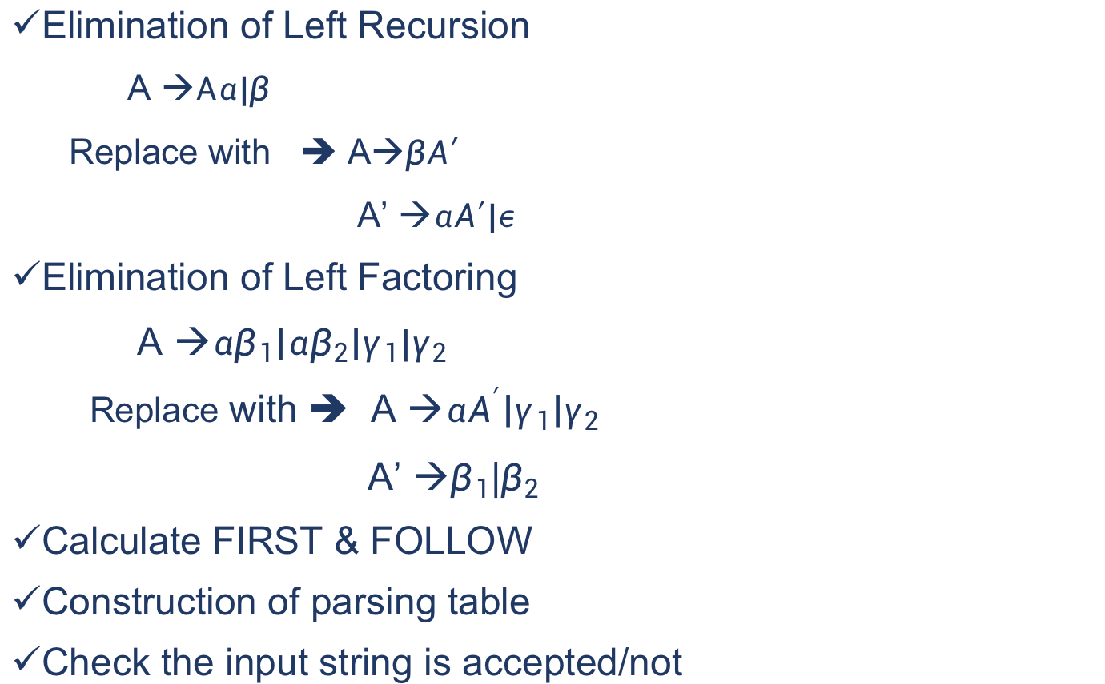
Construction LL(1) Parser
Elimination of Left Recursion
A →$Aα|β$
Replace with ➔ A→$βA′$
A’ →$αA′|ε$
Elimination of Left Factoring
A →$αβ_{1}\left|αβ_{2}\right|γ_{1}|γ_{2}$
Replace with ➔ A →$αA^{′}\left|γ_{1}\right|γ_{2}$
A’ →$β_{1}$|$β_{2}$
Calculate FIRST & FOLLOW
Construction of parsing table
Check the input string is accepted/not

Slide 31
Construction of Parsing Table
Rules
for each production rule A → α of a grammar G
for each terminal a in FIRST(α) ➔ add A → α to M[A,a]
If ε in FIRST(α) ➔ for each terminal a in FOLLOW(A) add A → α to M[A,a]
If ε in FIRST(α) and $ in FOLLOW(A) ➔ add A → α to M[A,$]
All other undefined entries of the parsing table are error entries

Slide 32
LL(1) Parser – Example 1
E →E+T|T
T → T*F|F
F → (E) | id

Slide 33
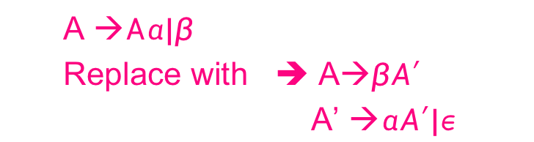
LL(1) Parser – Step 1 Eliminating Left Recursion
E →E+T|T
T → T*F|F
F → (E) | id
E → TE’
E’ → +TE’|ε
T → FT’
T’ → *FT’ |ε
F → (E) | id
A →$Aα|β$
Replace with ➔ A→$βA′$
A’ →$αA′|ε$

Slide 34

LL(1) Parser – Step 2 Eliminating Left Factoring
E → TE’
E’ → +TE’|ε
T → FT’
T’ → *FT’ |ε
F → (E) | id
A →$αβ_{1}\left|αβ_{2}\right|γ_{1}|γ_{2}$
Replace with ➔ A →$αA^{′}\left|γ_{1}\right|γ_{2}$
A’ →$β_{1}$|$β_{2}$

Slide 35
LL(1) Parser – Step 3 FIRST & FOLLOW
E → TE’
E’ → +TE’|ε
T → FT’
T’ → *FT’ |ε
F → (E) | id
FIRST(E) = {(,id}
FIRST(E’) = {+, ε}
FIRST(T) = {(,id}
FIRST(T’) = {*, ε}
FIRST(F) = {(,id}
FOLLOW(E) = { $, ) }
FOLLOW(E’) = { $, ) }
FOLLOW(T) = { +, $,) }
FOLLOW(T’) = { +, $,) }
FOLLOW(F) = {*,+, $,) }

Slide 36
LL(1) Parser – Step 4 Parsing Table
E → TE’ FIRST(TE’)={(,id} ➔ E → TE’ into M[E,(] and M[E,id]
E’ → +TE’ FIRST(+TE’ )={+} ➔ E’ → +TE’ into M[E’,+]
E’ → ε FIRST(ε)={ε} ➔ none
but since ε in FIRST(ε)
and FOLLOW(E’)={$,)} ➔ E’ → ε into M[E’,$] and M[E’,)]
T → FT’ FIRST(FT’)={(,id} ➔ T → FT’ into M[T,(] and M[T,id]
T’ → *FT’ FIRST(*FT’ )={*} ➔ T’ → *FT’ into M[T’,*]
T’ → ε FIRST(ε)={ε} ➔ none
but since ε in FIRST(ε)
and FOLLOW(T’)={$,),+} ➔ T’ → ε into M[T’,$], M[T’,)] and M[T’,+]
F → (E) FIRST((E) )={(} ➔ F → (E) into M[F,(]
F → id FIRST(id)={id} ➔ F → id into M[F,id]
FIRST(E) = {(,id}
FIRST(E’) = {+, ε}
FIRST(T) = {(,id}
FIRST(T’) = {*, ε}
FIRST(F) = {(,id}
FOLLOW(E) = { $, ) }
FOLLOW(E’) = { $, ) }
FOLLOW(T) = { +, $,) }
FOLLOW(T’) = { +, $,) }
FOLLOW(F) = {*,+, $,) }

Slide 37
LL(1) Parser – Step 4 Parsing Table Construction
E → TE’
E’ → +TE’|ε
T → FT’
T’ → *FT’ |ε
F → (E) | id
FIRST(E) = {(,id}
FIRST(E’) = {+, ε}
FIRST(T) = {(,id}
FIRST(T’) = {*, ε}
FIRST(F) = {(,id}
FOLLOW(E) = { $, ) }
FOLLOW(E’) = { $, ) }
FOLLOW(T) = { +, $,) }
FOLLOW(T’) = { +, $,) }
FOLLOW(F) = {*,+, $,) }
 | id | + | * | ( | ) | $
E | E → TE’ |  |  | E → TE’
E’ |  | E’ → +TE’ |  |  | E’ → ε | E’ → ε
T | T → FT’ |  |  | T → FT’
T’ |  | T’ → ε | T’ → *FT’ |  | T’ → ε | T’ → ε
F | F → id |  |  | F → (E)

Slide 38
LL(1) Parser – Parser Actions
The symbol at the top of the stack (say X) and the current symbol in the input string (say a) determine the parser action.
There are four possible parser actions.
If X and a are $ ➔ parser halts (successful completion)
If X and a are the same terminal symbol (different from $)
➔ parser pops X from the stack, and moves the next symbol in the input buffer.

Slide 39
LL(1) Parser – Parser Actions
3. If X is a non-terminal
➔ parser looks at the parsing table entry M[X,a]. If M[X,a] holds a production rule X→Y₁Y₂...Y_{k}, it pops X from the stack and pushes Y_{k},Y_{k-1},...,Y₁ into the stack. The parser also outputs the production rule X→Y₁Y₂...Y_{k} to represent a step of the derivation.
none of the above ➔ error
all empty entries in the parsing table are errors.
If X is a terminal symbol different from a, this is also an error case.

Slide 40
LL(1) Parser – Step 5: Example1
E → TE’
E’ → +TE’|ε
T → FT’
T’ → *FT’ |ε
F → (E) | id
 | id | + | * | ( | ) | $
E | E → TE’ |  |  | E → TE’
E’ |  | E’ → +TE’ |  |  | E’ → ε | E’ → ε
T | T → FT’ |  |  | T → FT’
T’ |  | T’ → ε | T’ → *FT’ |  | T’ → ε | T’ → ε
F | F → id |  |  | F → (E)
stack input output
$E id+id$ E → TE’
$E’T id+id$ T → FT’
$E’ T’F id+id$ F → id
$ E’ T’id id+id$ pop
$ E’ T’ +id$ T’ → ε
$ E’ +id$ E’ → +TE’
stack input output
$ E’ T+ +id$
$ E’ T id$ T → FT’
$ E’ T’ F id$ F → id
$ E’ T’id id$
$ E’ T’ $ T’ → ε
$ E’ $ E’ → ε
$ $ accept

Slide 41
LL(1) Parser – Tutorial 1
S → aBa
B → bB | ε
Check whether the given string abba is accepted by the LL(1) parser based on the above grammar. Show the leftmost derivation of the input string with parse tree.

Slide 42
LL(1) Parser - Solution
S → aBa LL(1) Parsing
B → bB | ε Table
stack input output
$S abba$ S → aBa
$aBa abba$
$aB bba$ B → bB
$aBb bba$
$aB ba$ B → bB
$aBb ba$
$aB a$ B → ε
$a a$
$ $ accept, successful completion
 | a | b | $
S | S → aBa
B | B → ε | B → bB

Slide 43
LL(1) Parser -Solution (cont)
Outputs: S → aBa B → bB B → bB B → ε
Derivation(left-most): S⇒aBa⇒abBa⇒abbBa⇒abba
S
parse tree
a
B
a
b
B
b
B
ε

Slide 44
LL(1) Parser – Tutorial 2
S → ( L )
S → a
L → S
L → L ; S
Construct the parsing table for the given grammar and check whether the grammar is LL(1) Grammar and the input string ((a;a)) is accepted by the parser

Slide 45
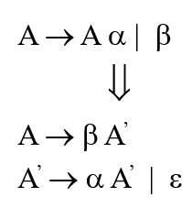
LL(1) Parser – Tutorial 2: Solution
S → ( L )
S → a
L → S
L → L ; S
Grammar after removal of Left Recursion
S → ( L )
S → a
L → SL'
L' → ;SL'
L' → ε

Slide 46
LL(1) Parser – Tutorial 2: Solution
Grammar after removal of Left Recursion
S → ( L )
S → a
L → SL'
L' → ;SL'
L' → ε
First(S) = { (, a }
First(L) = First(S) = { (, a }
First(L') = { ; , ε }
Follow(S) = { $, ), ; }
Follow(L) = { ) }
Follow(L') = { ) }

Slide 47
LL(1) Parser – Tutorial 2: Solution
Grammar after removal of Left Recursion
S → ( L )
S → a
L → SL'
L' → ;SL'
L' → ε
First(S) = { (, a }
First(L) = First(S) = { (, a }
First(L') = { ; , ε }
Follow(S) = { $, ), ; }
Follow(L) = { ) }
Follow(L') = { ) }
 | a | ( | ) | ; | $
S | S → a | S → (L)
L | L → SL' | L → SL'
L' |  |  | L' → ε | L' → ;SL'

Slide 48
LL(1) Parser – Tutorial 2: Solution
Grammar after removal of Left Recursion
S → ( L )
S → a
L → SL'
L' → ;SL'
L' → ε
Sl.No | Stack | Input | Output/Action
1 | $S | ( ( a ; a ) )$ | S → ( L )
2 | $)L( | ( ( a ; a ) )$ | match (
3 | $)L | ( a ; a ) )$ | L → SL'
4 | $)L'S | ( a ; a ) )$ | S → (L)
5 | $)L')L( | ( a ; a ) )$ | match (
6 | $)L')L | a ; a ) )$ | L → SL'
7 | $)L')L'S | a ; a ) )$ | S → a
8 | $)L')L'a | a ; a ) )$ | match a
9 | $)L')L' | ; a ) )$ | L' → ;SL'
10 | $)L')L'S; | ; a ) )$ | match ;
11 | $)L')L'S | a ) )$ | S → a
12 | $)L')L'a | a ) )$ | match a
13 | $)L')L' | ) )$ | L' → ε
14 | $)L') | ) )$ | match )
15 | $)L' | )$ | L' → ε
16 | $) | )$ | match )
17 | $ | $ | Accept
 | a | ( | ) | ; | $
S | S → a | S → (L)
L | L → SL' | L → SL'
L' |  |  | L' → ε | L' → ;SL'

Slide 49
LL(1) Parser – Tutorial 3
S → i C t S E | a
E → e S | ε
C → b
Construct the parsing table for the given grammar and check whether the grammar is LL(1) Grammar.

Slide 50
Solution: A Grammar which is not LL(1)
S → i C t S E | a FOLLOW(S) = { $,e }
E → e S | ε FOLLOW(E) = { $,e }
C → b FOLLOW(C) = { t }
FIRST(iCtSE) = {i}
FIRST(a) = {a}
FIRST(eS) = {e}
FIRST(ε) = {ε}
FIRST(b) = {b}
two production rules for M[E,e]
Problem ➔ ambiguity
 | a | b | e | i | t | $
S | S → a |  |  | S → iCtSE
E |  |  | E → e S E → ε |  |  | E → ε
C |  | C → b

Slide 51
A Grammar which is not LL(1) (cont.)
What do we have to do it if the resulting parsing table contains multiply defined entries?
If we didn’t eliminate left recursion, eliminate the left recursion in the grammar.
If the grammar is not left factored, we have to left factor the grammar.
If its (new grammar’s) parsing table still contains multiply defined entries, that grammar is ambiguous or it is inherently not a LL(1) grammar.
A left recursive grammar cannot be a LL(1) grammar.
A → Aα | β
any terminal that appears in FIRST(β) also appears FIRST(Aα) because Aα ⇒ βα.
If β is ε, any terminal that appears in FIRST(α) also appears in FIRST(Aα) and FOLLOW(A).

Slide 52
A Grammar which is not LL(1) (cont.)
A grammar is not left factored, it cannot be a LL(1) grammar
A → αβ₁ | αβ₂
any terminal that appears in FIRST(αβ₁) also appears in FIRST(αβ₂).
An ambiguous grammar cannot be a LL(1) grammar.

Slide 53
Properties of LL(1) Grammars
A grammar G is LL(1) if and only if the following conditions hold for two distinctive production rules
A → α and A → β
Both α and β cannot derive strings starting with same terminals.
At most one of α and β can derive to ε.
If β can derive to ε, then α cannot derive to any string starting with a terminal in FOLLOW(A).

Slide 54
Thank you

